Slide 1
Open Data and Where to Find It
Mongolian Open Data Sources
Robert Ritz

Slide 2
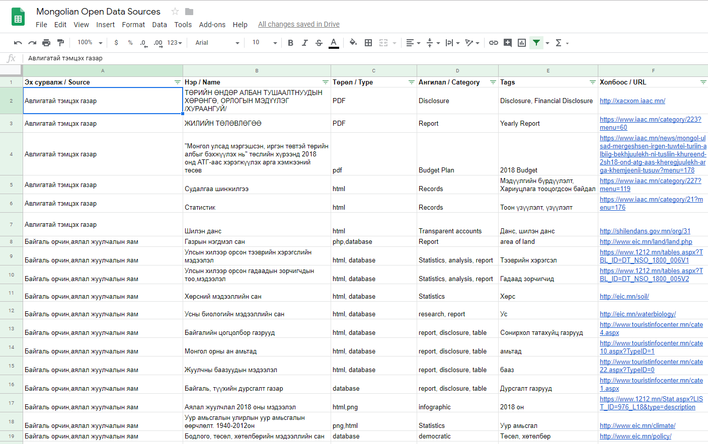
Open Data List
Google Sheets
http://bit.ly/mongoliadata
Эх сурвалж – government ministry of agency
Нэр – Description of data
Төрөл – format of data
Ангилал –category of data
Tags (work in progress)
Холбоос – link to data

Slide 3
Representation of list
Nearly every ministry is represented on the list
It is not exhaustive
Most agencies are not represented
Survey of available data found on ministry websites

Slide 4
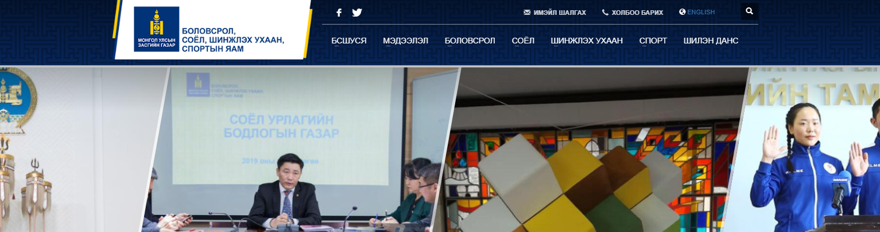
Data is generally not useful by itself
Reports generally only measure one thing
  Number of students
  Number of schools
Combining those can tell you the average size of schools
Combine with other data and you could answer other questions!

Slide 5
Lot’s of PDFs
Most of the data on this list is stored in PDF format
Will take a lot of manual work to make it usable

Slide 6
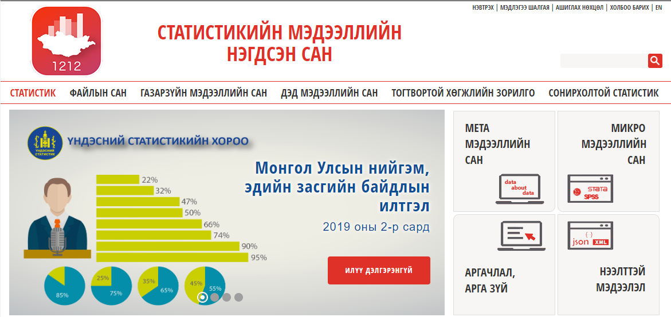
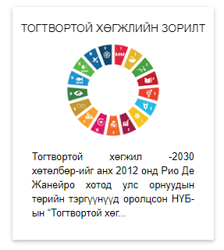
National Statistical Office
NSO has a very organized and large list of open data
Over 700 tables of data, organized by category
1212.mn

Slide 7
Useful links
Open data list (Google Sheets): http://bit.ly/mongoliadata
National Statistical Office: 1212.mn
Good luck on your data search!

